Slide 1
Fantasy Football
Data Science Challenge
October 2025

Slide 2
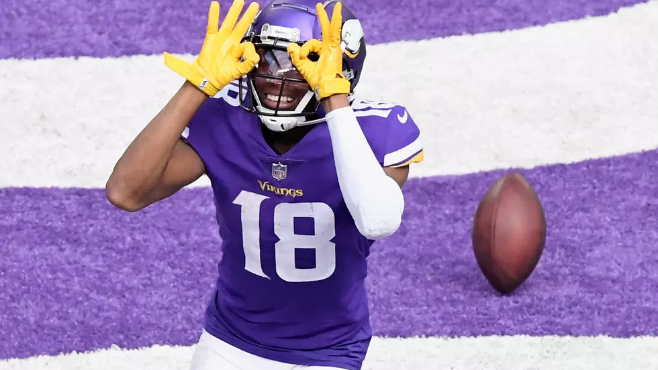
Data Science Challenge
Agenda:
Purpose
Rules
Winning
Post Activity
Time Line

Slide 3
Why Play?
You like fantasy sports
You’re interested in trying “DFS-style” instead of a home league
You want to learn more about modeling/optimization
You want some insight that will help you win your home league
You like competition (and having fun!)
Notes:
* Draft on weekly basis?

Slide 4
Contest Rules
General
Model must make picks (honor system)
1-3 members per team
Weekly Goal
Score most fantasy points compared to other models
End of Season Goal
Score most fantasy points overall
1st place, 2nd place
Most innovative model
Punting Challenge
Notes:
* Draft on weekly basis?

Slide 5
Game Rules
Weekly Challenge
$50,000 salary cap
Will pick 9 Players (1 QB, 2 RBs, 3 WRs, 1 FLEX, 1 TE, 1 DEF)
Salaries will be released Wednesday
Rosters From each Team submitted Thursday
10 weeks in the season (NFL weeks 9-18)
No Playoffs
Quirky Rules
0.5 PPR
No Kickers
Notes:
* Draft on weekly basis?

Slide 6
Punting Challenge
Season-Long Challenge
Select 1 Punter per week to score the highest points
Most cumulative points at the end of the season wins
Kicker Scoring
Punt attempts * 3pts
Kick yards * 0.01pts
Punt lands inside 20 * 2pts
Return yards * -0.01 pts
Blocks * -3pts
Touchbacks * -2pts
Return Touchdown * -6pts
Notes:
* Draft on weekly basis?

Slide 7
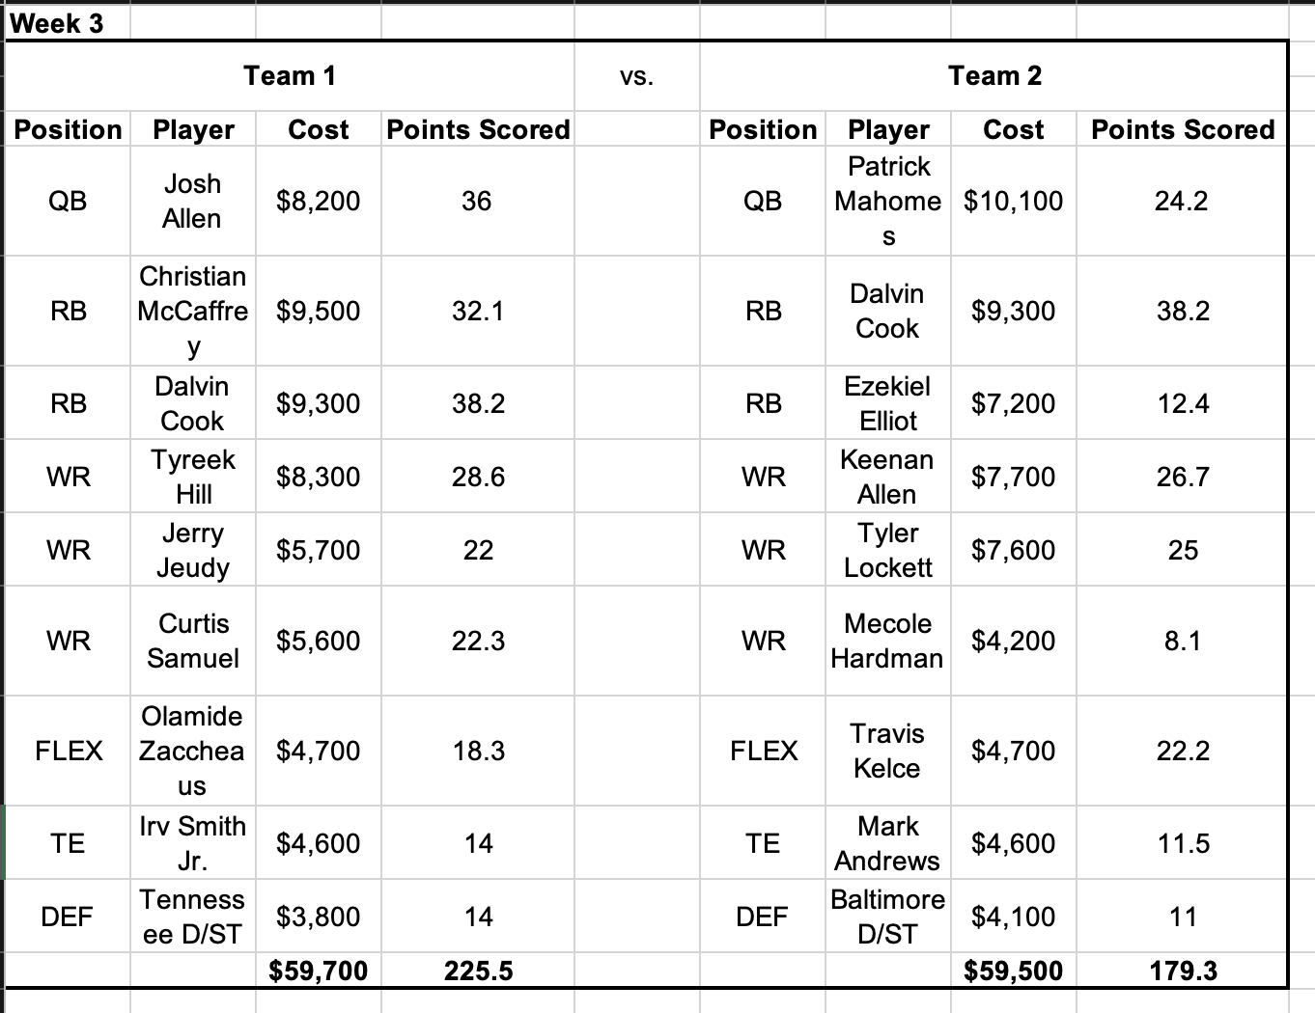
Weekly Matchups
Notes:
* Draft on weekly basis?

Slide 8
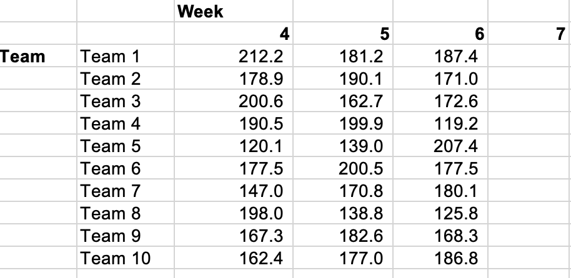
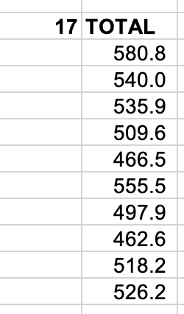
Weekly Points
Notes:
* Draft on weekly basis?

Slide 9
Weekly Prizes
Each Week
10 weeks in season
BAH swag up for grabs each week
Notes:
* Draft on weekly basis?

Slide 10

End-of-Season
Reward Structure
Each week score the most points to win swag
4 payouts totaling $125 up for grabs
Payouts in Gift cards (TBD)
Highest points scored $50
Second highest points scored $25
Most innovative model: $25
Punting Challenge: $25
Notes:
* Draft on weekly basis?

Slide 11
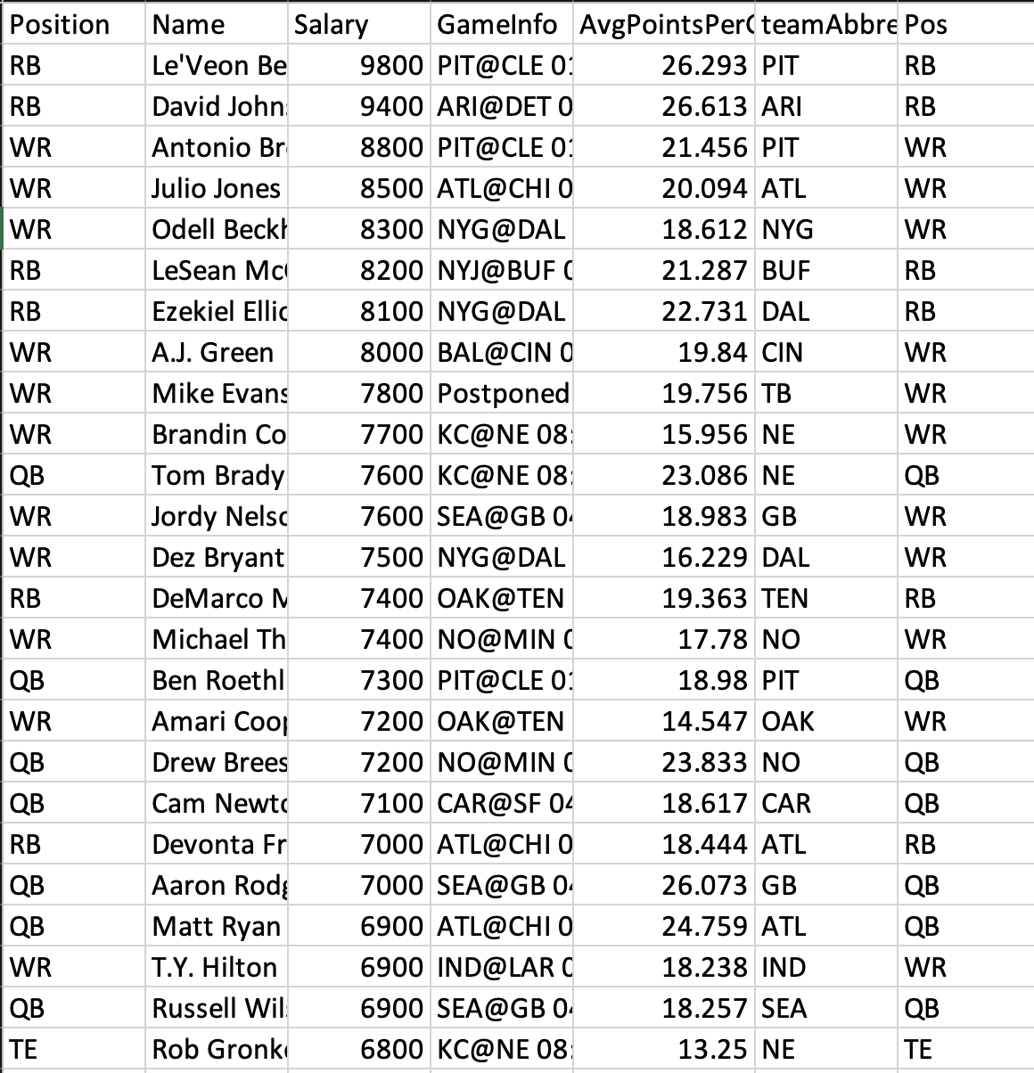
Data Sources
Player Salary Data
DraftKings salary cap data and rules
Rotowire.com
Weekly matchup data
Pro-football-reference.com
Other Stats
Can be collected by each team from their own data sources
For Example: catches, historical points, rushing yards, etc.
Notes:
Draft on weekly basis?
Fantasy pros

Slide 12
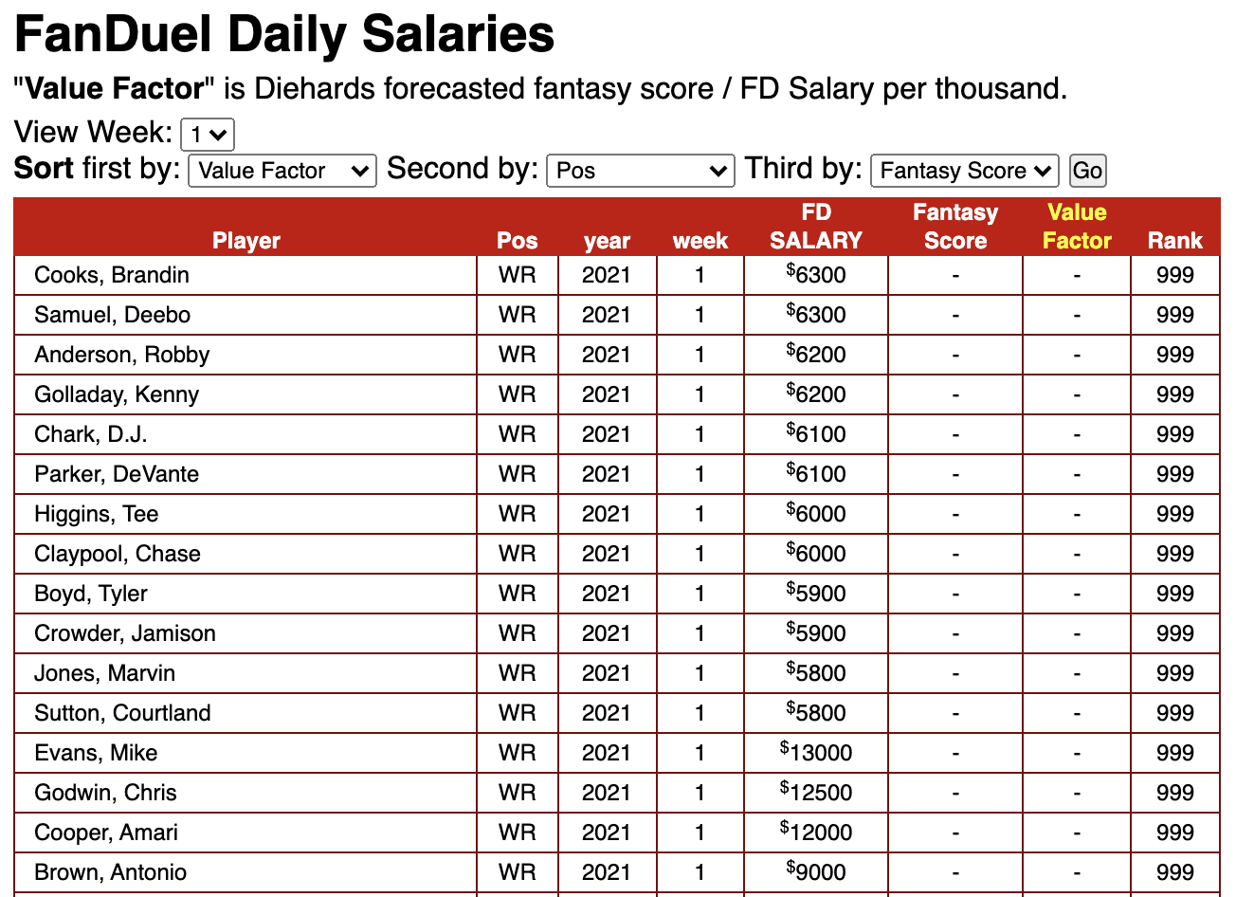
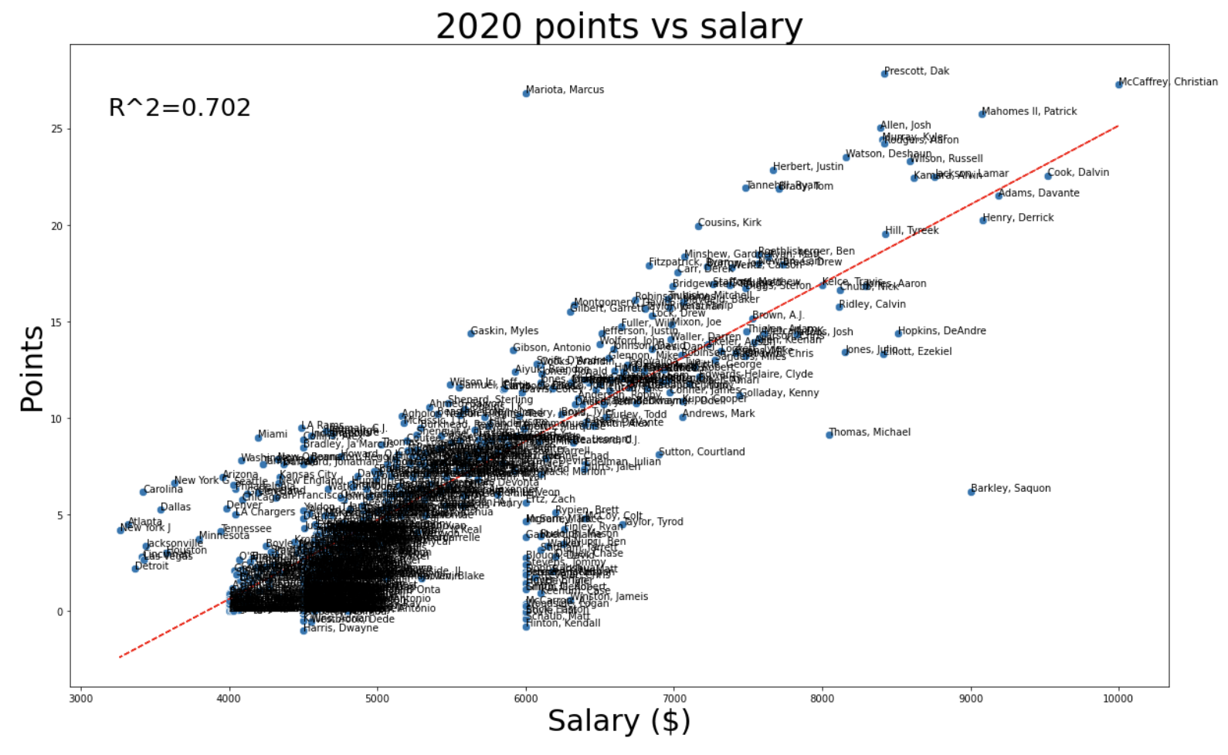
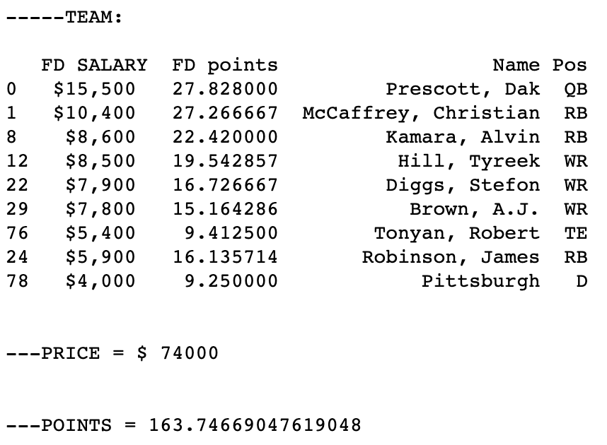
Sample Model
Notes:
Draft on weekly basis?
Fantasy pros

Slide 13
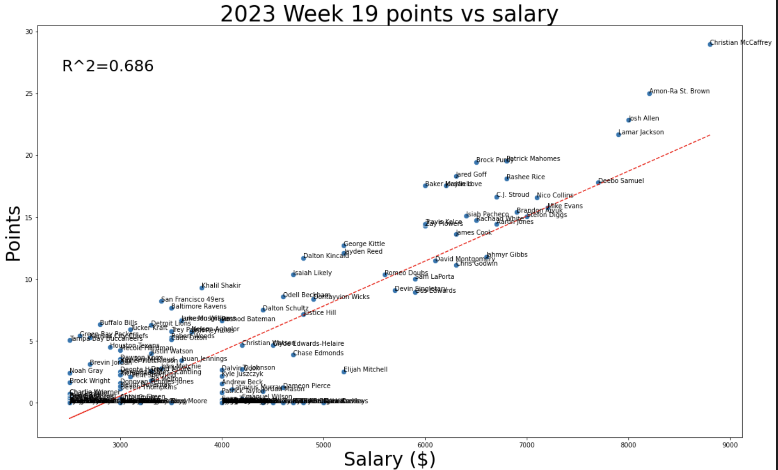
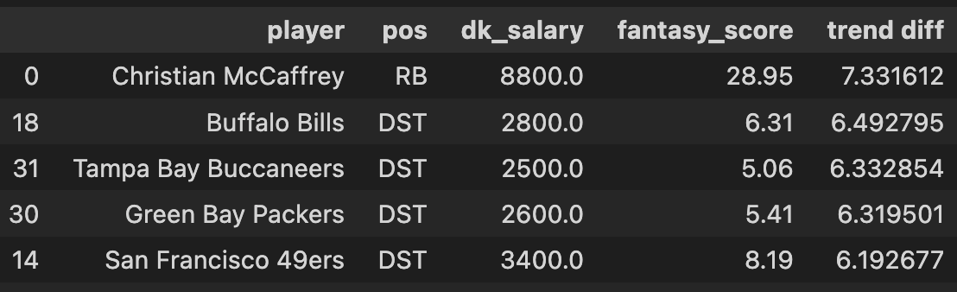
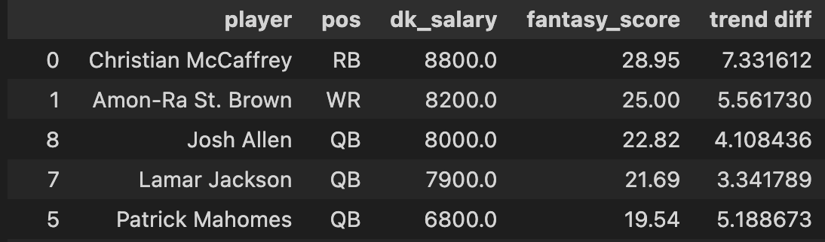
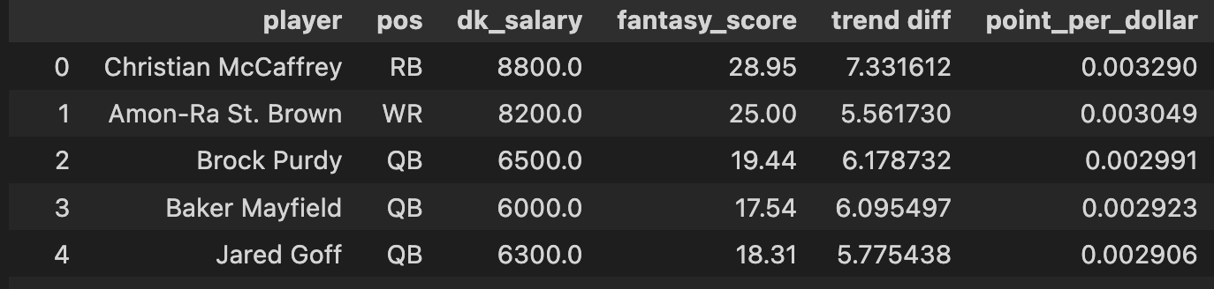
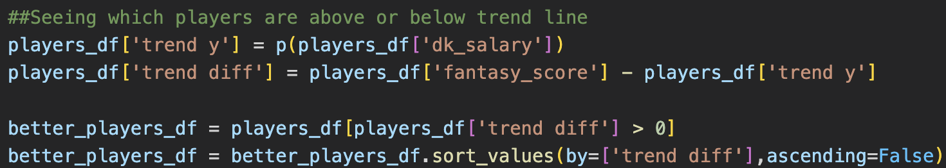
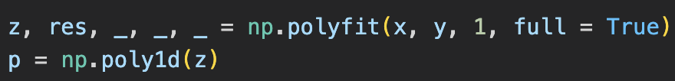
Antonio’s Model
Notes:
Draft on weekly basis?
Fantasy pros

Slide 14
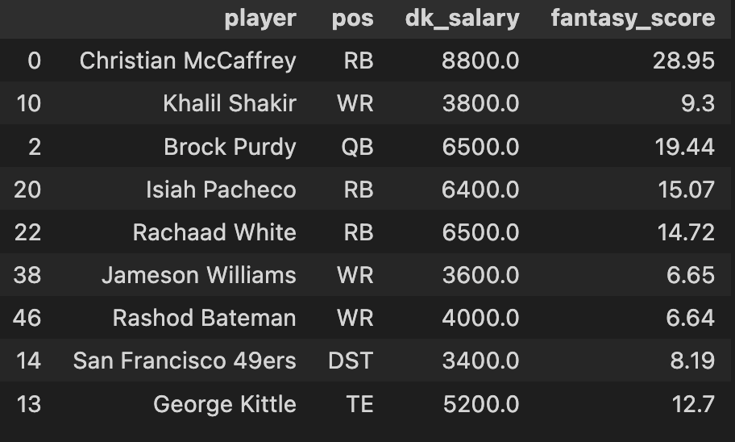
Greedy Picks (sort of)
Pick RB and WR with best “trend diff”
Pick best “point per dollar” QB
Pick next best two “point per dollar” RBs
Pick next best two “trend diff” OR “point per dollar” WRs that only cost ½ of remaining salary
Pick highest scoring defense OR best “point per dollar” defense OR best “trend diff” defense
Pick best “trend diff” TE I can afford
​
Notes:
Draft on weekly basis?
Fantasy pros

Slide 15
Every Monday Night Scores are calculated and weekly winners are determined
Oct 27: Kickoff Meeting
Jan 4: Last week of our season
Oct 20: Slack announcement of competition
Every Wednesday Salaries are released
Season Prep
Regular Season
Post Season
Oct 21: Open House
~Jan 20: Contest Winners are announced and
After Action Review
conducted
Every Thursday team picks due by noon PCT
Notes:
Pre- Season
Tell League Managers about interest and team composition before Week 4
Venmo League managers $10
Receive invite to Slack Channel/OneDrive
Pre-season meeting with every model team
During the Week
NFL games run Thursday night to Monday night
FanDuel Salaries posted on Wednesday in OneDrive Excel sheet
Players post selections on Thursday in OneDrive Excel sheet
League managers update weekly scores/money earned
End-of-Season
After action meeting at the end to discuss models
Award best model prize

Slide 16
Questions?

